Slide 1
Psychophysics Software Suite
Yearly project for Dr. Karen Banai

Slide 2
General Description
The project aim was to provide a simple GUI based application that would allow to find a minimal difference that a listener can detect along various acoustic parameters (e.g., frequency, duration, AM, FM, duration of gap in noise or between noise and tone)
There are several commercial applications that provide similar functionality , but no GPL ones.

Slide 3
Types of Sound Stimuli Supported
Pure Tone
  Harmonic single frequency generated sound
Accord
  The sound consist of a number of harmonics
Noise
  Random noise with a ability to define its spectrum
Modulated
  Amplitude or frequency modulated sound
Gap
  Two sounds with a user defined gap between

Slide 4
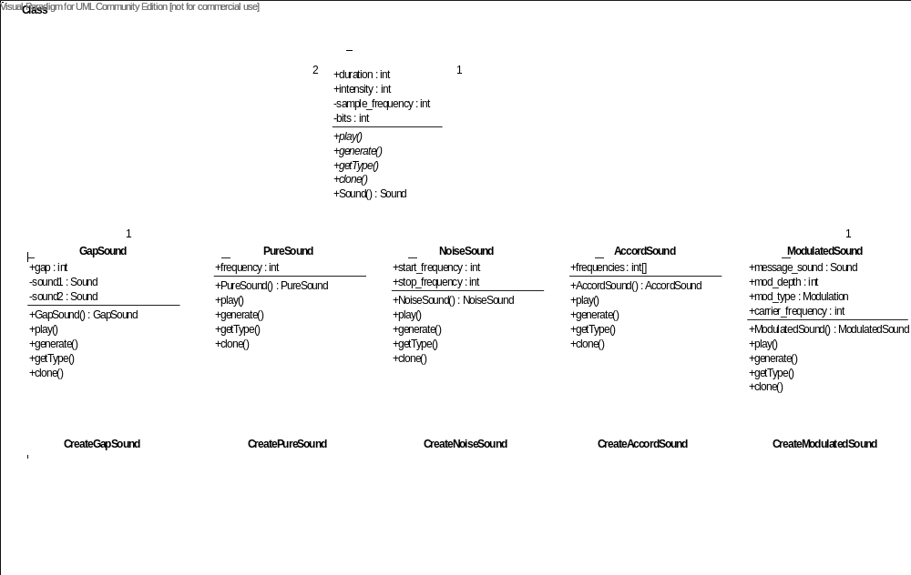
The cornerstone: Sound

Slide 5
The Tools
Test Tool
  The applet allows to compose or edit PSS test scenario according to the needs.
Run Tool
  The applet launches composed PSS test scenario and saves the collected test results.
Analysis Tool
  The applet allows to open and analyze PSS test results.

Slide 6
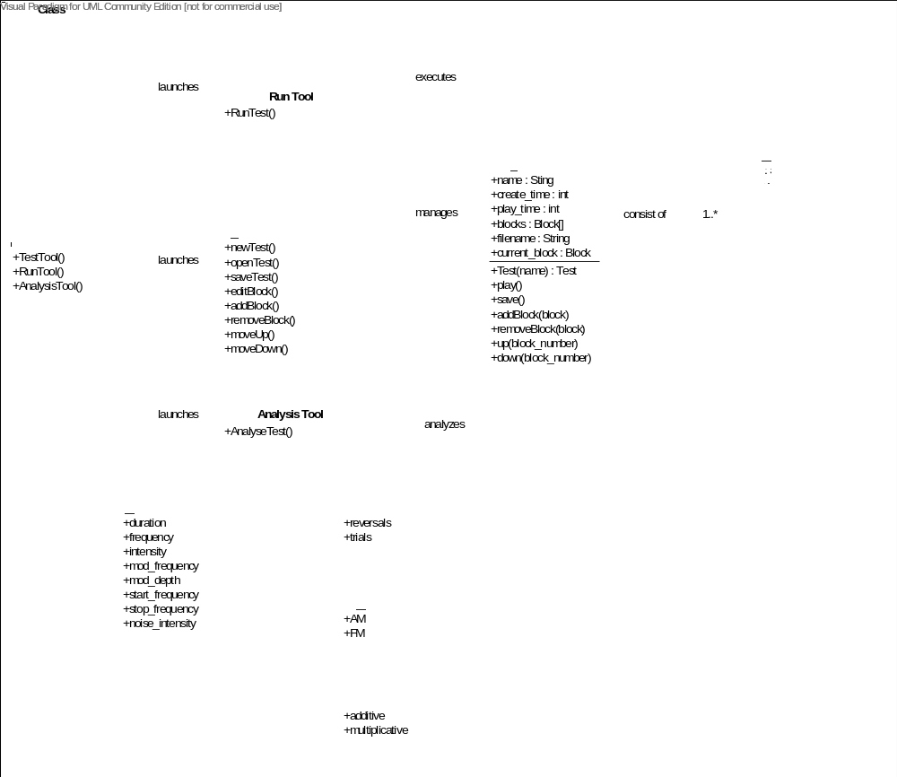
PSS Test

Slide 7
Architecture
PSS Application
Matlab
PSS GUI
Java Virtual machine

Slide 8
Problems and Solutions (1)
How to combine the client requirements of implementation under Matlab and a requirement of project modularity and scalability?
To use Matlab OOP ( available from Matlab version R2008a and up)

Slide 9
Problems and Solutions (2)
Matlab object fields names are changed or created in code, but are inaccessible by the script.
It’s not a bug, it’s a feature. ☺
The feature is needed to speed up Matlab OOP scripts , so object fields are cached.
Restart Matlab to correct the problem.

Slide 10
Problems and Solutions (3)
Matlab lacks thread programming , yet there is a need in simultaneous video play (GUI mouse dance ) and sounds’ generation.
We’re used the fact that Matlab is build on Java platform, so it’s possible to integrate Java JFrame class ( PSS GUI) with Matlab script.
Several Java threads were used inside JFrame.

Slide 11
Problems and Solutions (4)
How to synchronize various blocks inside PSS Test with Matlab ?
To use standard Matlab waitfor() with a hidden object, whose property change triggers the next block.

Slide 12
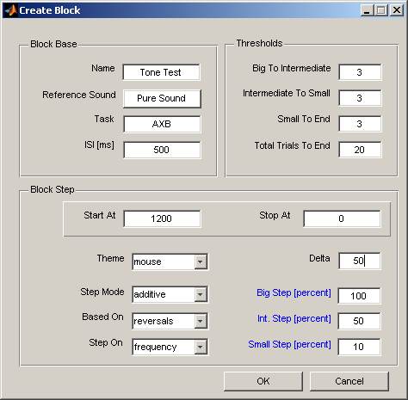
Example

Slide 13
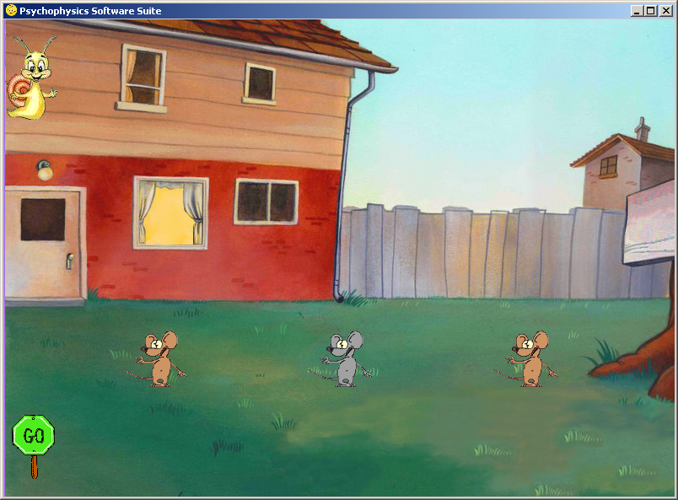

Slide 14
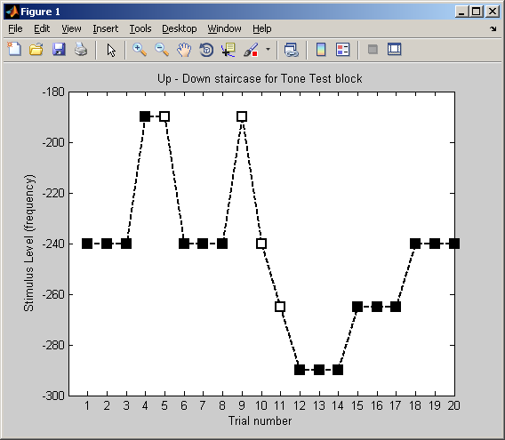
Results

